Slide 1
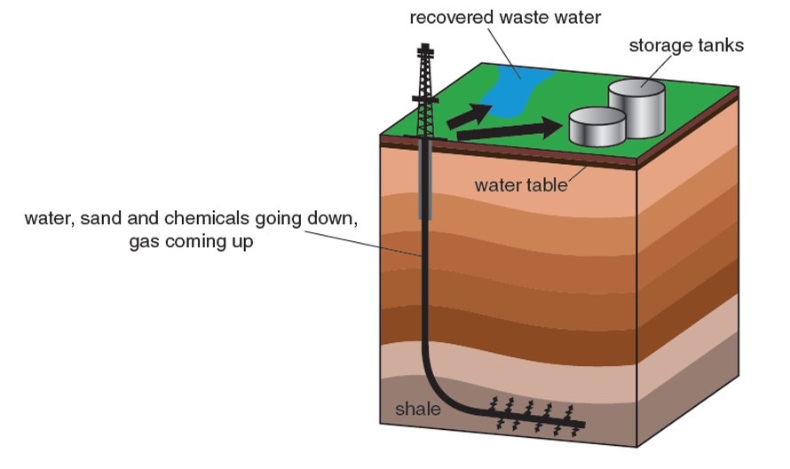
Background:
Energy is distributed unevenly across the world. Different countries and demographic groups experience different levels of energy security (A) Since industrialisation, the energy mix of countries has been changing over time (B) The use of non-renewables increased rapidly with industrialisation, but there use is declining as populations become aware of the different challenges and opportunities (C) The use of renewables has been increasing in recent years (D) Fracking is the process of releasing gas trapped in shale rock by pumping water and sand into the ground (E) There are different opportunities and challenges presented by developing fracking in Blackpool (F)
B. | The changing
Energy efficiency |  | Using less energy to perform the same task.
Climate change |  | The process of the Earth’s climate changing over time
Imports |  | Goods brought into a country
Energy consumption |  | The amount of energy used by an individual or group
E. | Fracking
Fracking |  | The process of releasing gas trapped in shale rock by pumping water and sand in to the ground
Water table |  | The level below which the ground is saturated with water.
C. | Non-renewables
Coal |  | A combustible black or dark brown rock formed through the decomposition of organisms over millions of years
Natural gas and oil |  | Naturally occurring chemicals made from the decomposition of organisms over millions of years.
Decomposition |  | The state of rotting; decay.
A. | Energy distribution
Energy security |  | To be relatively self-sufficient in energy supply.
Energy poverty |  | A lack of energy infrastructure and resources.
Renewable energy sources |  | Energy which is infinite, sustainable and is easily replenished.
Non renewable energy sources |  | Energy which is finite, not sustainable and takes a long time to replenish.
Social wellbeing |  | Normally refers to quality of life e.g. happiness
Economic wellbeing |  | Having present and future financial stability
F. | Blackpool fracking
OPPORTUNITIES
Blackpool council could earn £1.7 million per year through fracking. Energy bills could fall by 2%. The UK could be self-sufficient in energy for years to come. Jobs would be created in an area known for high unemployment.
CHALLENGES
Air pollution and noise pollution from the heavy machinery used in fracking. Mini earthquakes could take place. The water which is pumped into the ground could pollute the water supply. Rural areas such as the area around Roseacre Wood could be destroyed.
D. | Renewables
Infinite |  | Limitless or endless
NIMBY |  | Abbreviation for ‘not in my backyard’
Wind energy |  | Turbines use energy from the wind to generate electricity either on land or at sea
Solar energy |  | Energy from the sun is used to heat water or to generate electricity using photovoltaic cells
Geothermal energy |  | Underground reservoirs of hot water can be used to heat buildings
Hydroelectric power |  | Water is trapped by a dam and allowed to fall through turbines. This turns the turbines and generates electricity.
Biomass |  | Wood, plants or animals burnt for power
Energy

